Slide 1
Final Game Presentaion

Slide 2
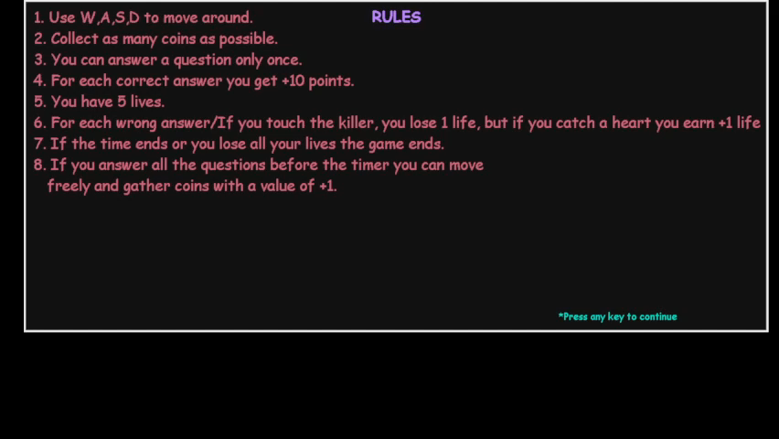
Game Demonstration

Slide 3
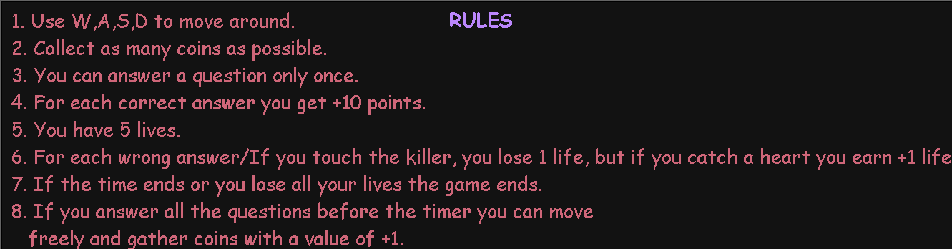
Game explanation
Well the Rules will show at the beginning, but here they are shown here too

Slide 4
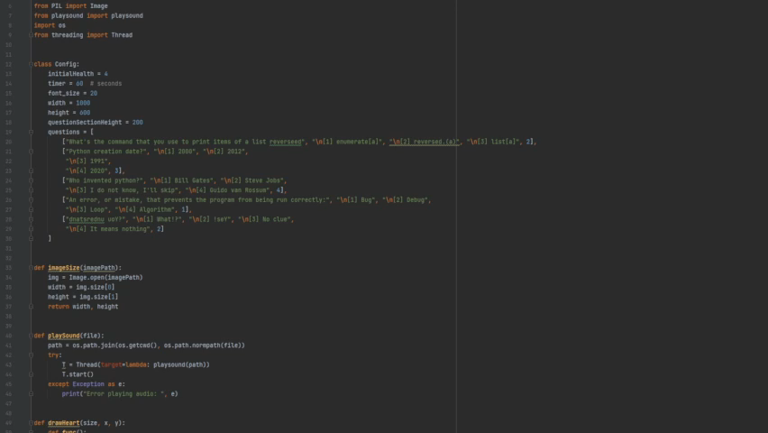
Code Review

Slide 5
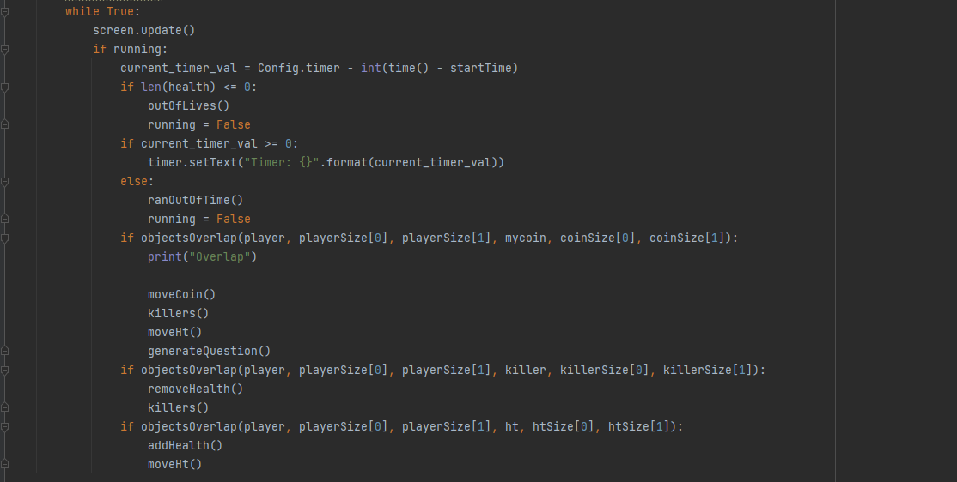
The main parts of the game code
In order to make the game work the developer added the overlap function which works by detecting if the images dimensions overlap which is going to trigger a True or False value which is used to add/remove health, so the scoring system to. I’ve added two new features which make the game more acctractive to new players. I added one killer and life saver which goes to a random position when the player earns score. So to check for overlapping we need to put the detecting definition to run rapidly, we can do that by putting it in a while loop. In the loop we check for the hearts number, time, overlapping and updating changes that happened to the screen.

Slide 6
Thank You for your attention
For the updated code that I did, I’ve provided a link where you can download the files from my drive. https://drive.google.com/file/d/1KLacgZJJ85uU_to_0L1u8XYiklctKX76/view?usp=sharing

